Slide 1
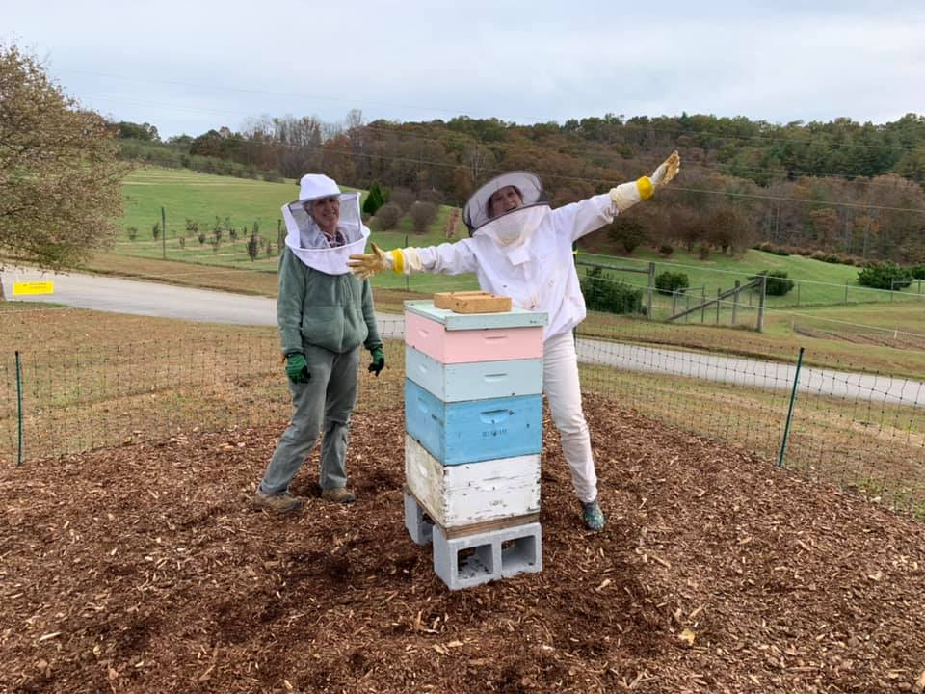

Introduction to Honey Bees
with a
Honey Tasting
Becky Griffin
UGA Community
& School Garden Coordinator
Pollinator Health Associate
Georgia Certified Beekeeper
beckygri@uga.edu

Slide 2
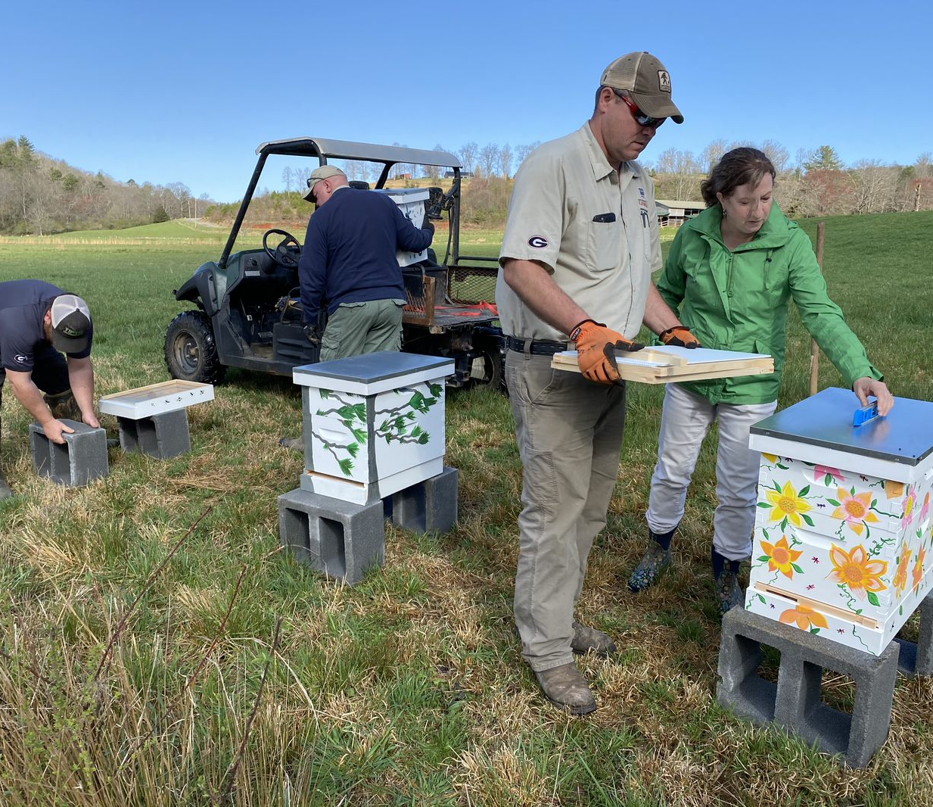
The University of Georgia is one of many universities from across the world that participate in honey bee research. This research is important understanding honey bee health.
Welcome to the fascinating world of honey bees!

Slide 3
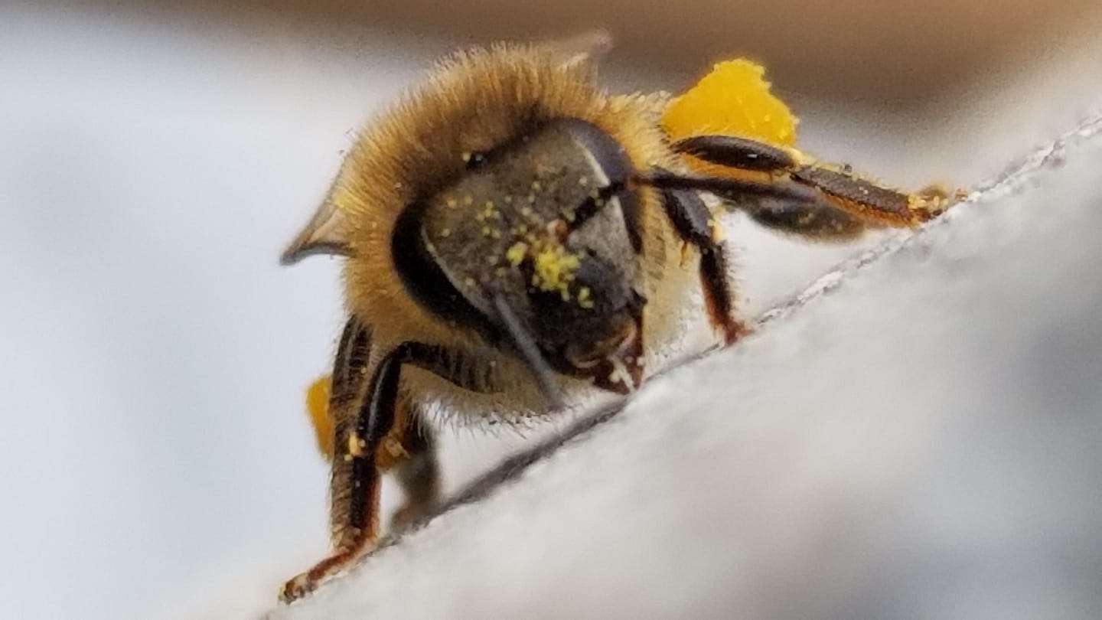
This is a honey bee forager. Her job is to forage for pollen and nectar. You can see the pollen she has gathered on her face and on her hind legs in pollen baskets (called corbiculae). She will bring this pollen back to the hive where it will be stored in beeswax combs. The pollen is a protein source for the bees.
Honey Bee
Apis Mellifera

Slide 4
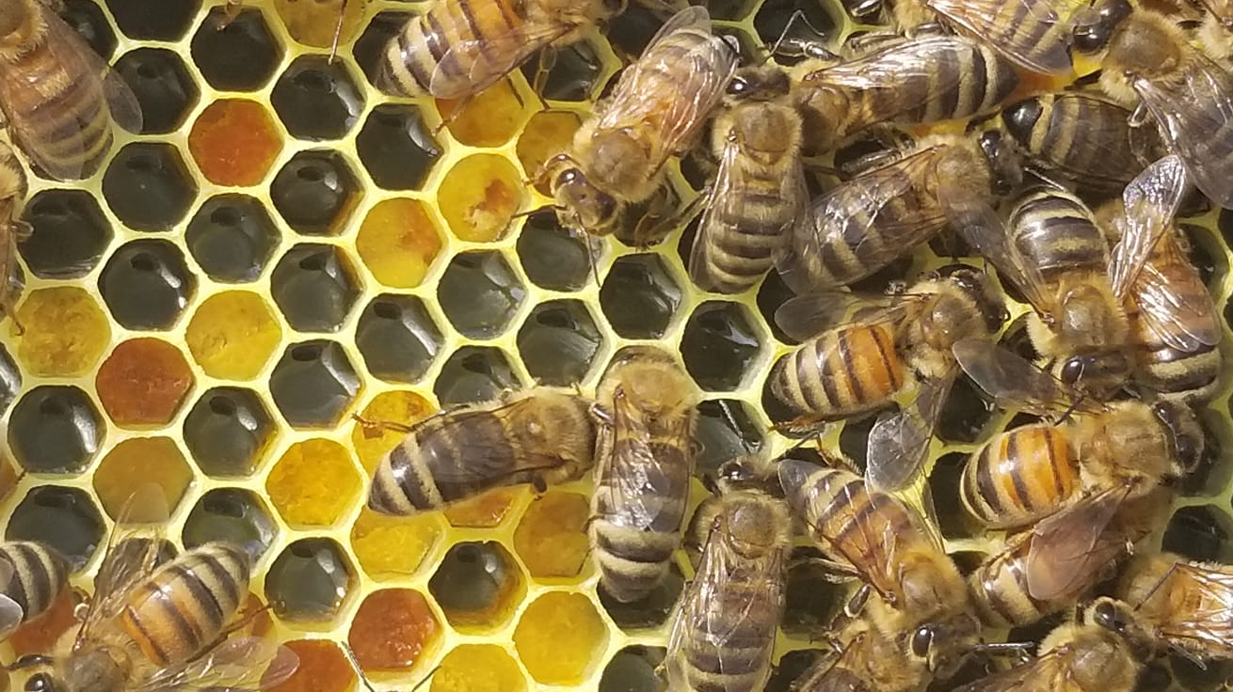
This is beeswax comb full of pollen that the bees brought home from foraging. Notice that pollen can be all different colors.

Slide 5
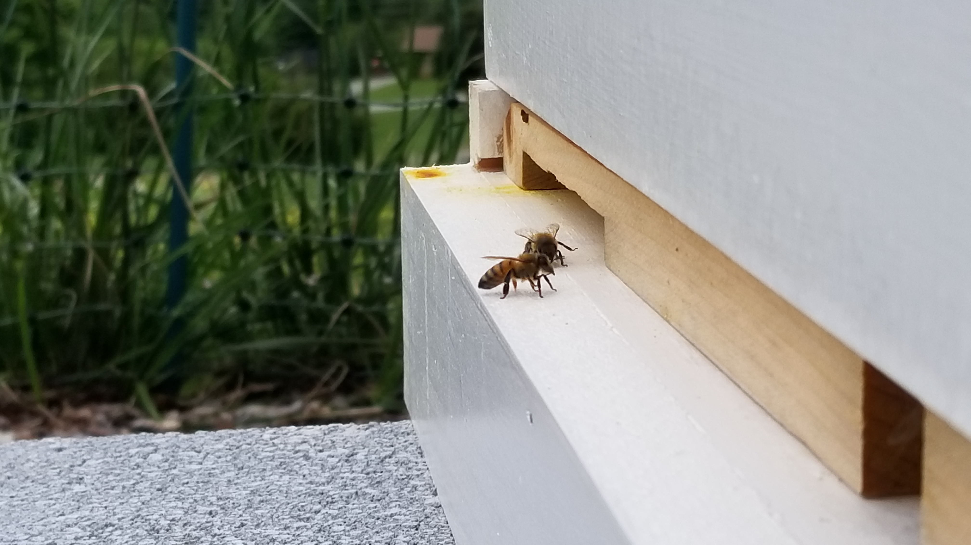
This is a honey bee forager returning from gathering nectar. She has traveled up to five miles to find a good nectar source. The nectar is stored in her honey stomach until she returns home to the hive where it will be deposited in beeswax comb.

Slide 6
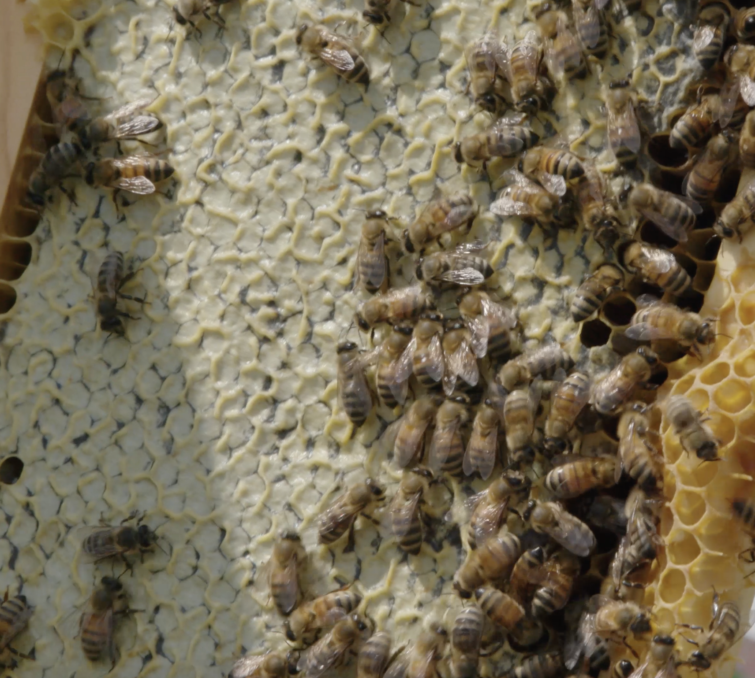
Once nectar is delivered from the bee’s honey stomach into the wax comb, sister bees use their wings to evaporate some of the water from the nectar. When the nectar is approximately 18% water, the nectar is now honey. The bees cap it with a wax cap for storage. It is an energy source for the bees, full of nutrition.

Slide 7
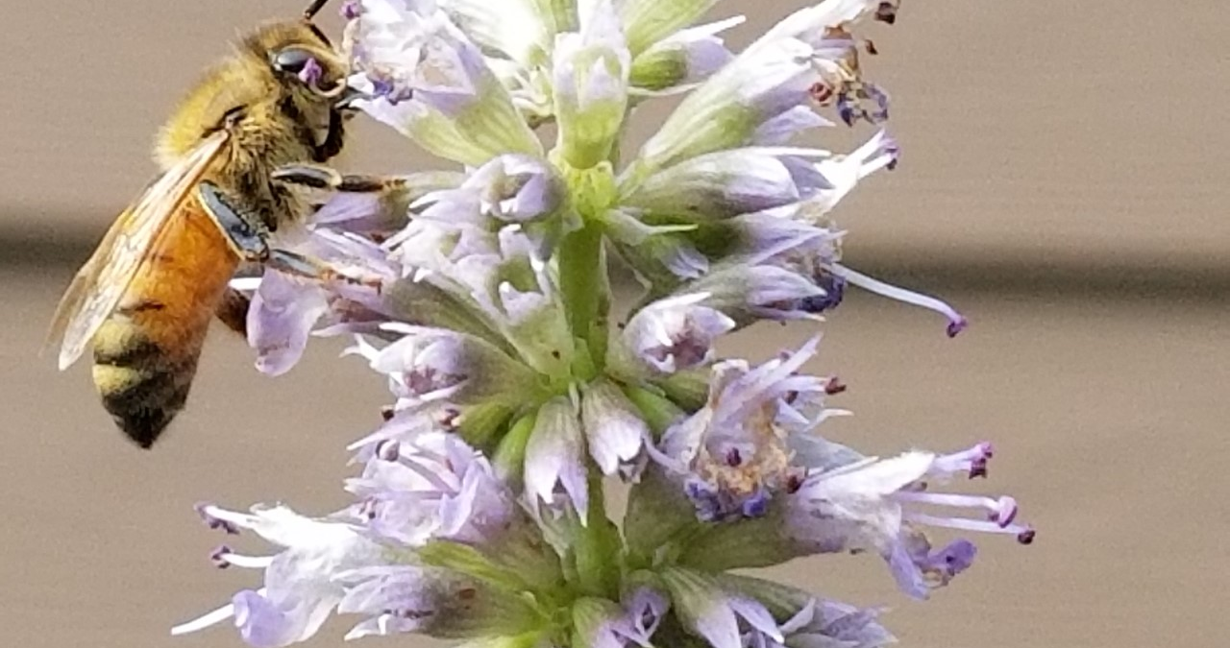
Look for honey bees is foraging nectar in your garden.

Slide 8
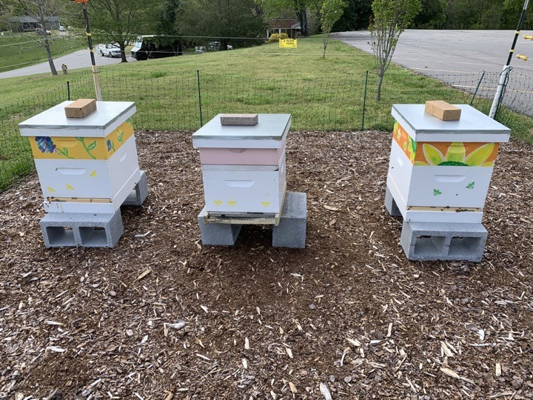
A honey bee lives in a hive with thousands of other worker bees and just one queen bee. Foraging bees are all female workers.

Slide 9
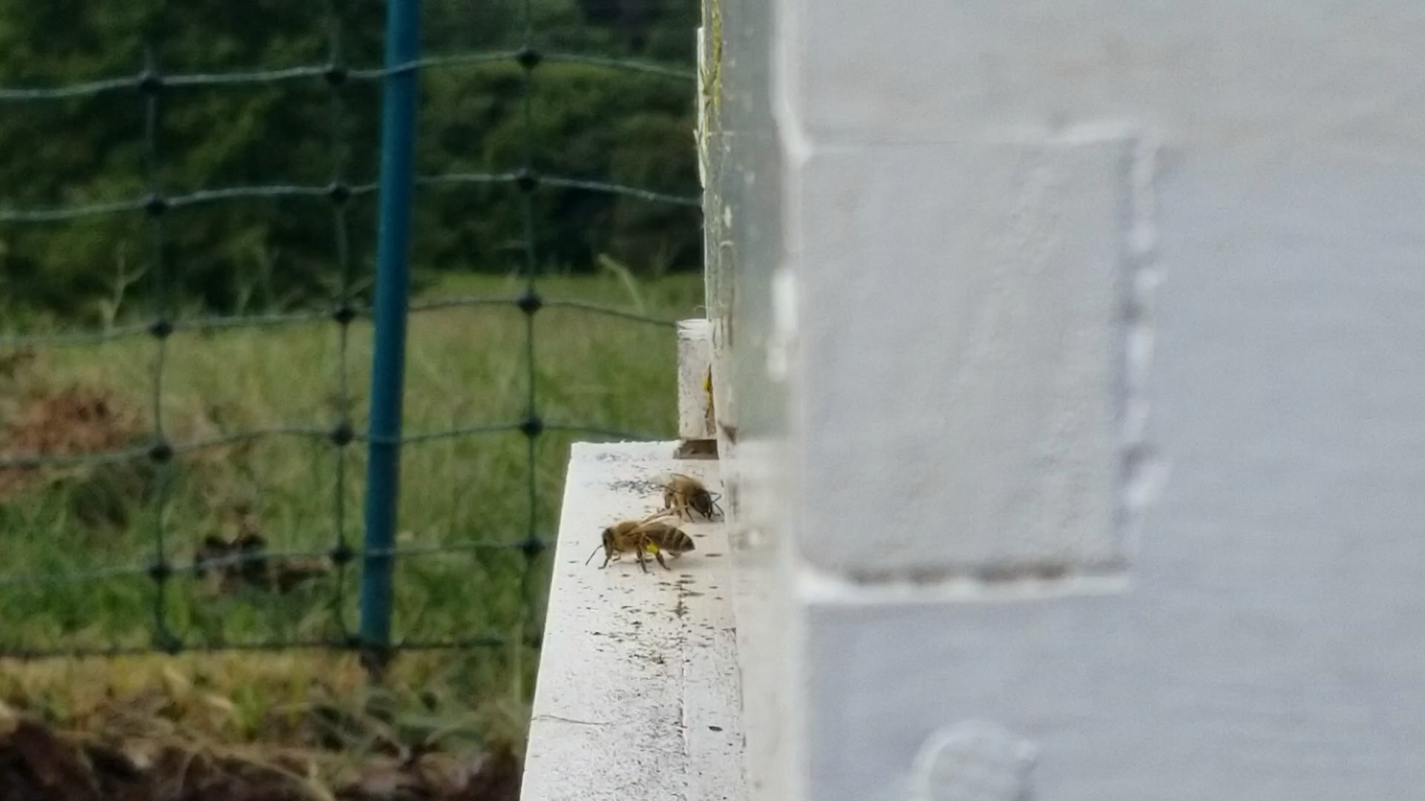
Notes:
Notice the bees flying into the hive with pollen in their pollen baskets

Slide 10
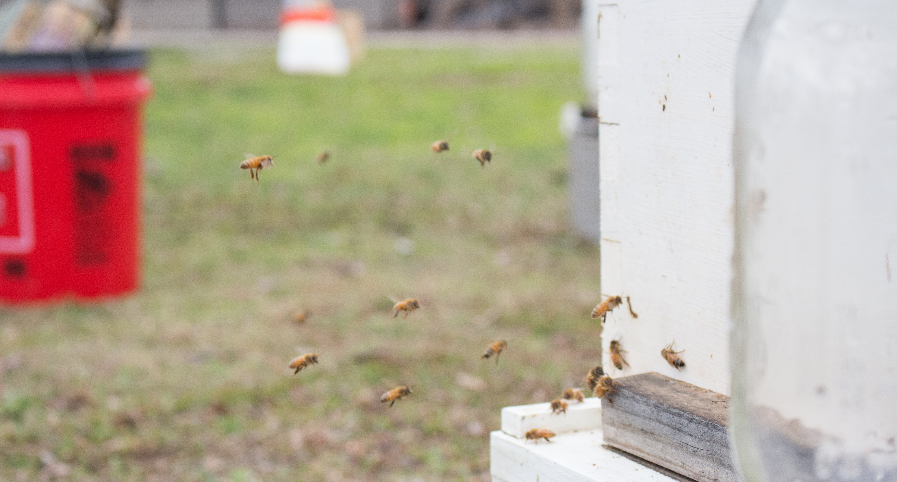
A honey bee can fly for up to five miles and as fast as 15 miles per hour. Their wings beat at 200 times per second. Each honey bee makes about 1/12th of a teaspoon of honey in its lifetime.

Slide 11
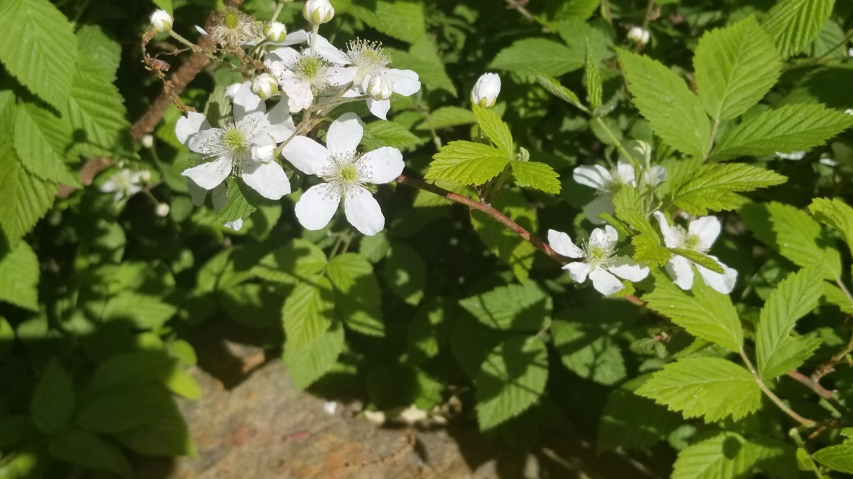
Honey is named for the primary plant blooming at the time the honey is made. Varieties include wildflower, orange blossom, sourwood and blackberry.
For example, native blackberries bloom in May. Bees visit the blackberry blossoms foraging for pollen and nectar and as a bonus they pollinate the blackberries. Although other things are blooming, here blackberry plants are the primary plants in bloom so the honey made at this time would be called blackberry honey.

Slide 12
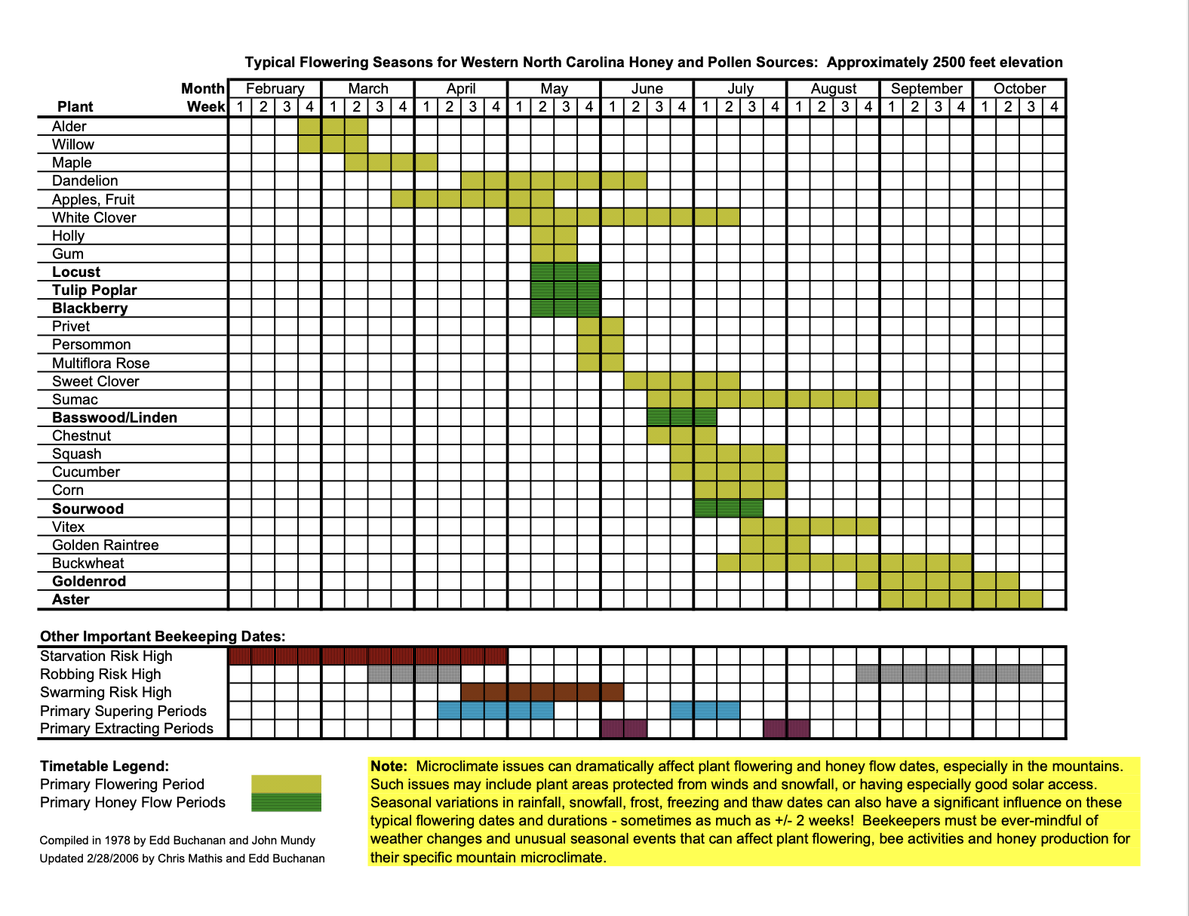
Notes:
Beekeepers keep track of flowering seasons of plants to know what kind of nectar their bees will be bringing in and what resulting honey their bees will make.

Slide 13
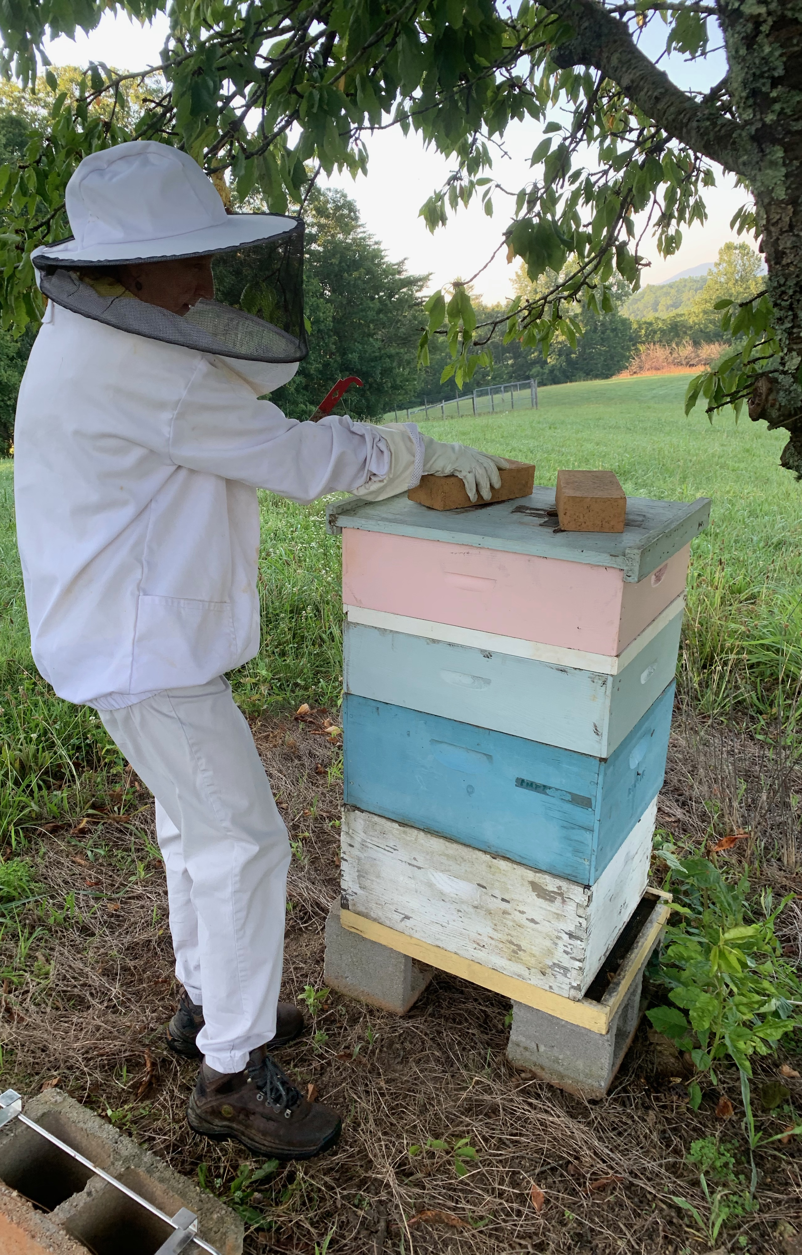
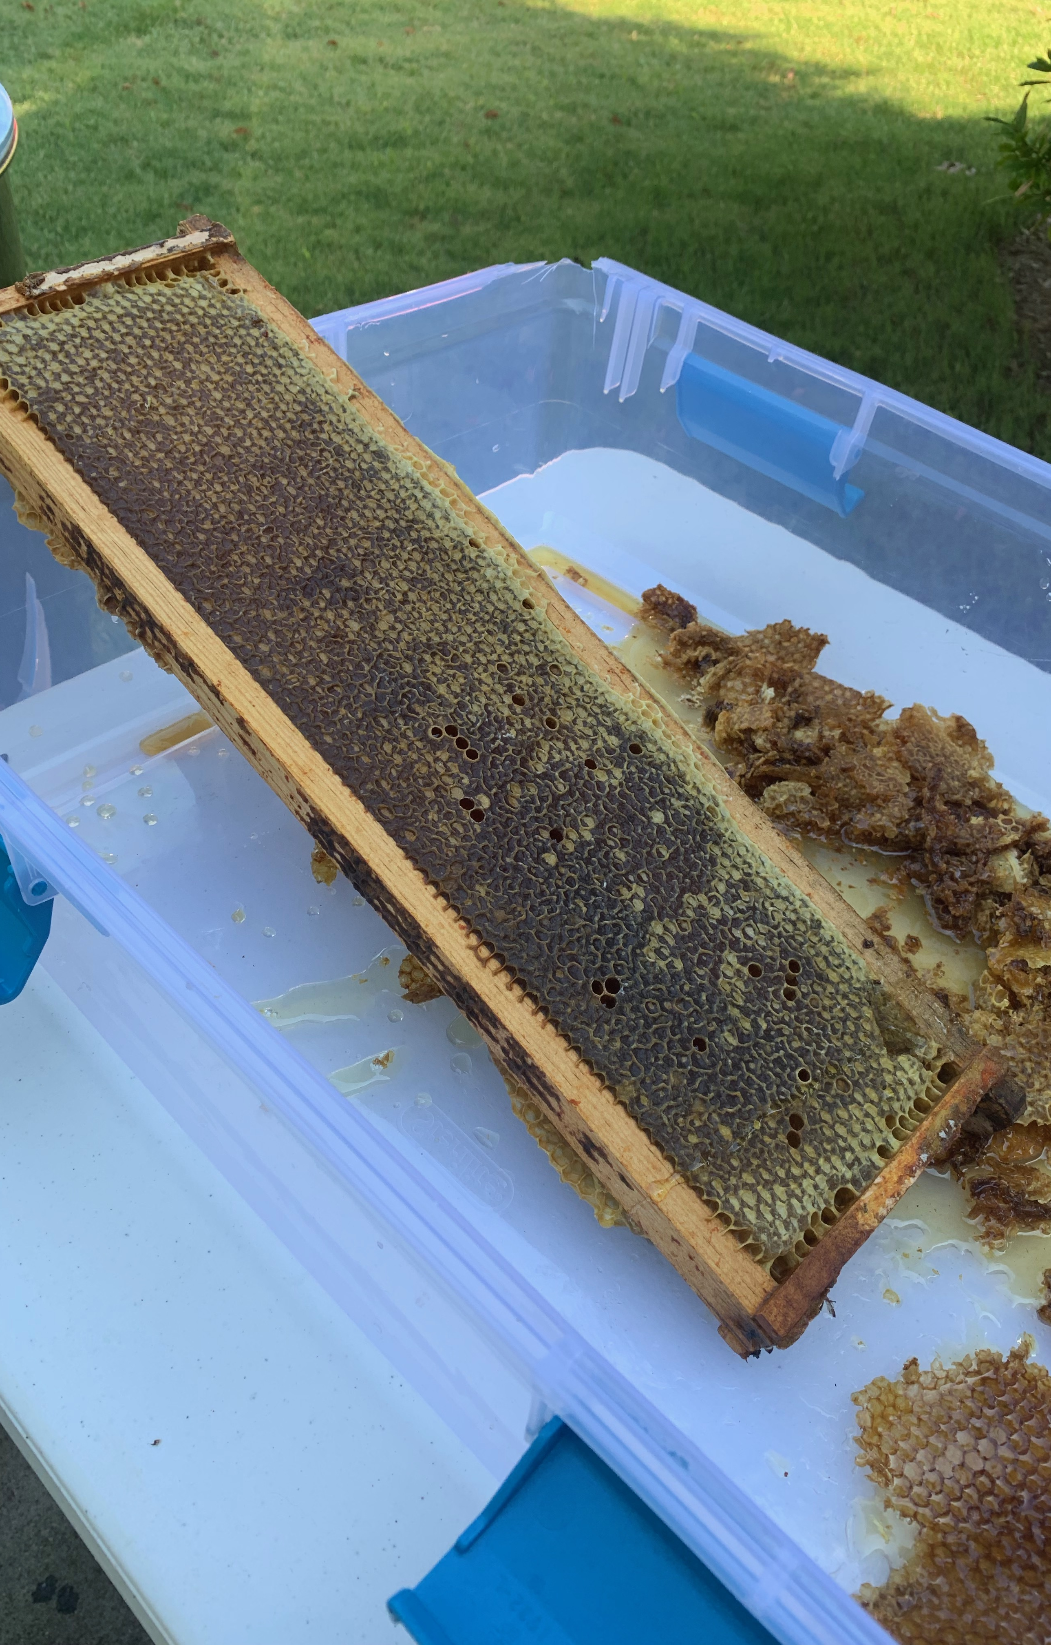
Beekeepers carefully remove honey comb frames from the hive for harvesting honey. It is important that the beekeeper leave enough honey for the bees.

Slide 14
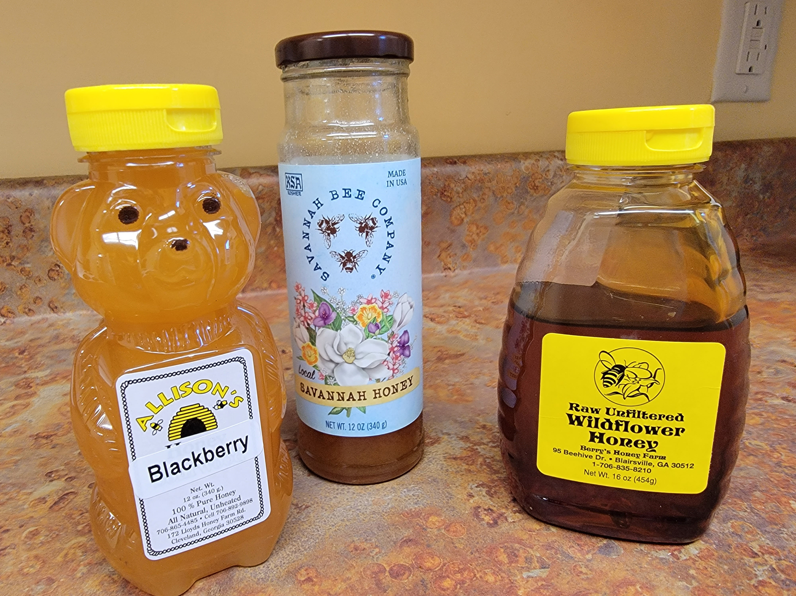
Let’s taste some honey!
Supplies:
Several varieties of honey purchased from local beekeepers.
1 oz clear plastic solo cups with lids to hold tasting honey.
Spoons for honey tasting
Water for drinking between tastes
Crackers to cleanse the palate between tastings
Paper towels (honey is sticky!)
Copies of the Honey Color Guide
Copies of the Honey Tasting Guide.
Pencils for note taking

Slide 15
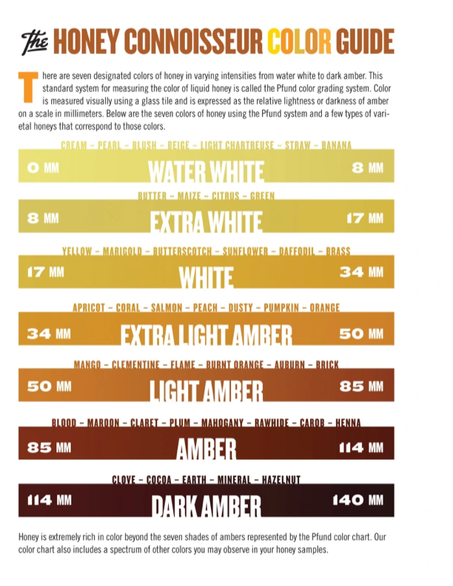
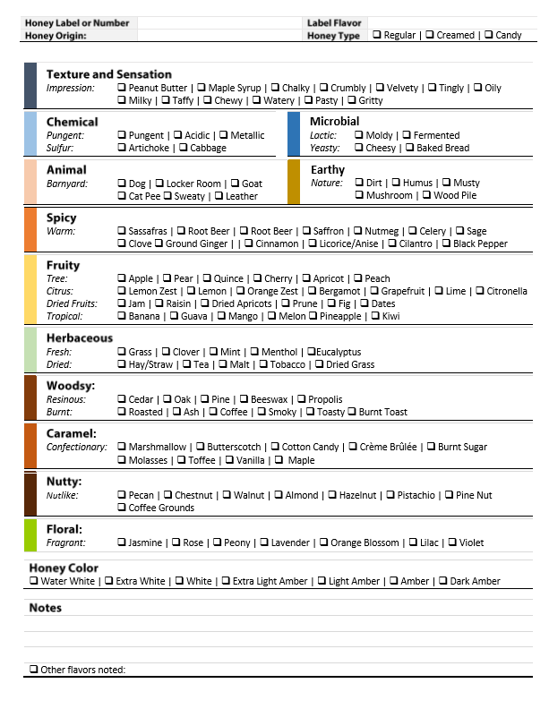
Notes:
Note: These sheets are found commonly on many sites on the internet. There does not seem to be anyone to credit for the sheets.

Slide 16
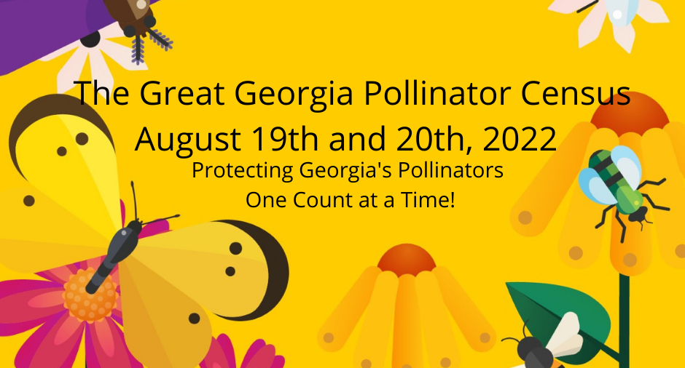
https://GGaPC.org
Notes:
Help Georgia’s bees by participating in the Great Georgia Pollinator Census

Slide 17
Introduction to Honey Bees
with a
Honey Tasting
Becky Griffin
UGA Community
& School Garden Coordinator
Pollinator Health Associate
Georgia Certified Beekeeper
beckygri@uga.edu

